Slide 1
Processes and Threads
In concurrent programming, there are two basic units of execution: processes and threads. In the Java programming language,
concurrent programming is mostly concerned with threads. However, processes are also important.
Threads are sometimes called lightweight processes. Both processes and threads provide an execution environment, but creating a new thread requires fewer resources than creating a new process.
A process has a self-contained execution environment. A process generally has a complete, private set of basic run-time resources; in particular, each process has its own memory space.
Processes
Threads

Slide 2
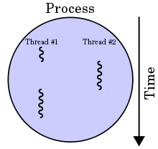
Processes and Threads
Threads exist within a process — every process has at least one. Threads share the process's resources, including memory and open files.
Multithreaded execution is an essential feature of the Java platform. Every application has at least one thread — or several, from the application programmer's point of view, you start with just one thread, called the main thread. This thread has the ability to create additional threads.
A process with two threads of
execution, running on a single
Processor.

